Slide 1

The study of Employee attrition & retention analysis
Presenting by,
Abdulkadir Siddiqui
Paresh Ruke
Deepak Gupta
Shaikh Mohammed Ghouse
Varaprasad Kotte

Slide 2
INTRODUCTION
Human Resource (HR) analytics, also known as people or workforce analytics, involves systematically collecting and analyzing HR data to enhance decision-making and boost organizational performance.
The HR Analytics Dashboard provides key insights into workforce dynamics, enabling data-driven decisions to enhance retention, engagement, and productivity. By visualizing metrics like attrition, compensation, and work-life balance, it helps identify trends, address challenges, and align HR strategies with business goals.
This tool fosters equitable practices and positions the organization as an employer of choice.

Slide 3
DATA OVERVIEW
Datasets- HR1 & HR2
Total 50000 rows & 35 Columns.
Employee working History.
Common column- employee ID
40 years Dataset.

Slide 4
OBJECTIVES
The main objective of all the KPIs is to evaluate and optimize workforce dynamics by identifying trends, challenges, and opportunities in key areas like employee retention, compensation, tenure, and job satisfaction.
This helps in making data-driven decisions to improve employee engagement, reduce attrition, and foster a balanced, productive, and equitable workplace.
To monitor employee turnover across the organization and identify departments with higher attrition rates for targeted retention strategies.

Slide 5
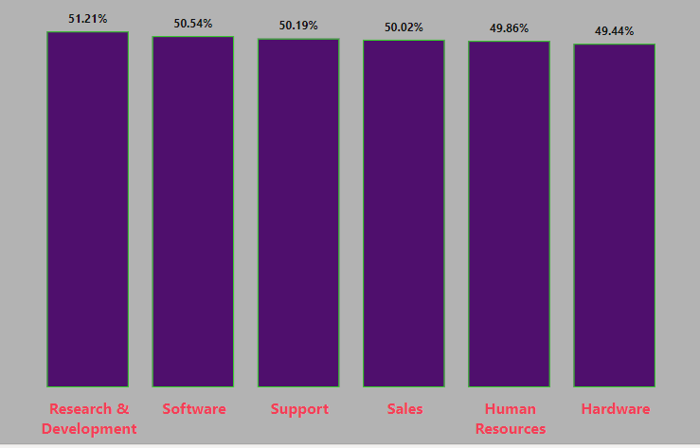
KPI :1- Average attrition rate for all departments
High attrition rates in specific departments indicate dissatisfaction or challenges such as poor management, limited growth opportunities, or workload imbalances.
Actionable Insight: Targeted interventions, such as leadership development or workload redistribution, are required.

Slide 6
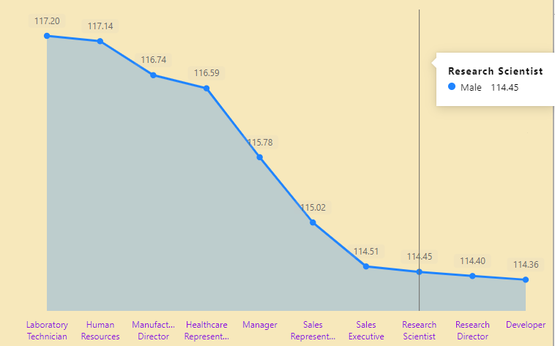
KPI :2 – Average hourly rate of male research scientist
Disparities in compensation may lead to dissatisfaction and turnover.
Actionable Insight: Regular benchmarking against industry standards and addressing pay gaps are crucial for fairness and retention.

Slide 7
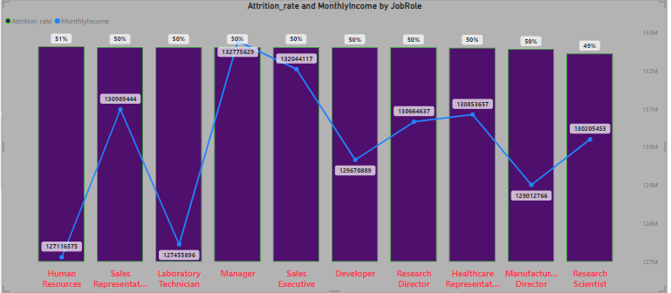
KPI :3 – Attrition rate vs monthly income stats
Employees in lower income brackets are more likely to leave, indicating compensation as a major factor in retention.
Actionable Insight: Enhance benefits, provide financial incentives, and ensure transparency in pay structures.

Slide 8
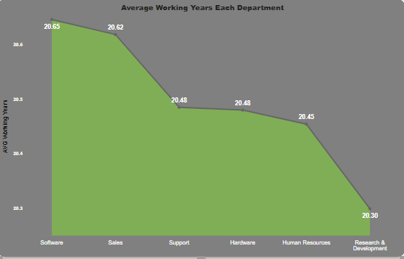
KPI :4 – Average working years for each department
Short average tenure in some departments suggests instability or lack of satisfaction.
Actionable Insight: Strengthen onboarding, provide growth opportunities, and address departmental culture issues.

Slide 9
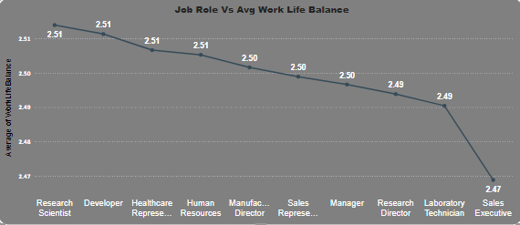
KPI :5 – Job role vs work life balance
Poor work-life balance in certain roles contributes to burnout and attrition.
Actionable Insight: Introduce flexible work arrangements, improve workload management, and provide wellness resources.

Slide 10
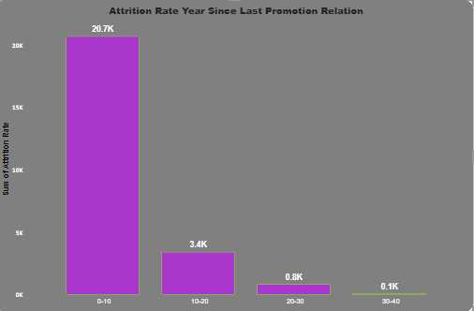
KPI :6 – Attrition rate vs year since last promotion relation
Longer intervals since the last promotion correlate with higher turnover rates.
Actionable Insight: Implement clear promotion criteria and timelines to motivate employees and retain top talent.

Slide 11
INSIGHTS
Attrition Drivers: High turnover is linked to factors such as compensation, lack of career progression, poor work-life balance, and department-specific challenges.
Compensation Gaps: Disparities in pay and below-market rates significantly impact employee satisfaction and retention.
Work-Life Balance: Roles with poor work-life balance experience higher burnout and attrition.
Career Growth: Employees with limited promotion opportunities are more likely to leave.
Tenure Dynamics: Short tenures in certain departments point to issues like poor onboarding or dissatisfaction with management.

Slide 12
RECOMMENDATIONS
Address Compensation Issues: Benchmark salaries against industry standards and rectify any disparities. Offer performance-based bonuses and financial incentives to retain top talent.
Enhance Career Development: Provide transparent promotion criteria and timelines. Invest in training, mentorship programs, and career pathing to support employee growth.
Improve Work-Life Balance: Introduce flexible working arrangements, such as hybrid or remote work. Monitor and manage workloads to reduce stress and prevent burnout.
Focus on Department-Specific Interventions: Identify departments with high attrition or short tenures and address their unique challenges. Provide targeted leadership training and foster supportive team environments.
Strengthen Employee Engagement: Conduct regular feedback sessions and act on employee concerns. Recognize and reward employee contributions through monetary and non-monetary means.

Slide 13
Conclusion
The KPIs reveal that compensation, work-life balance, career growth, and department dynamics are critical to employee retention and satisfaction.
Addressing these factors with targeted strategies will enhance engagement, reduce attrition, and create a supportive, high-performing workplace, positioning the organization as an employer of choice.
By leveraging the insights from the data, implementing equitable compensation policies, fostering career development opportunities, and promoting work-life balance, the organization can enhance employee engagement, reduce turnover, and create a supportive, growth-oriented workplace. This approach positions the organization as a preferred employer, ensuring long-term success and alignment with strategic goals.

Slide 14


